Slide 1
AuE-8230 Autonomy: Science and Systems
Capstone Project
Review Presentation 3
Group 1: Chinmay Samak, Tanmay Samak

Slide 2
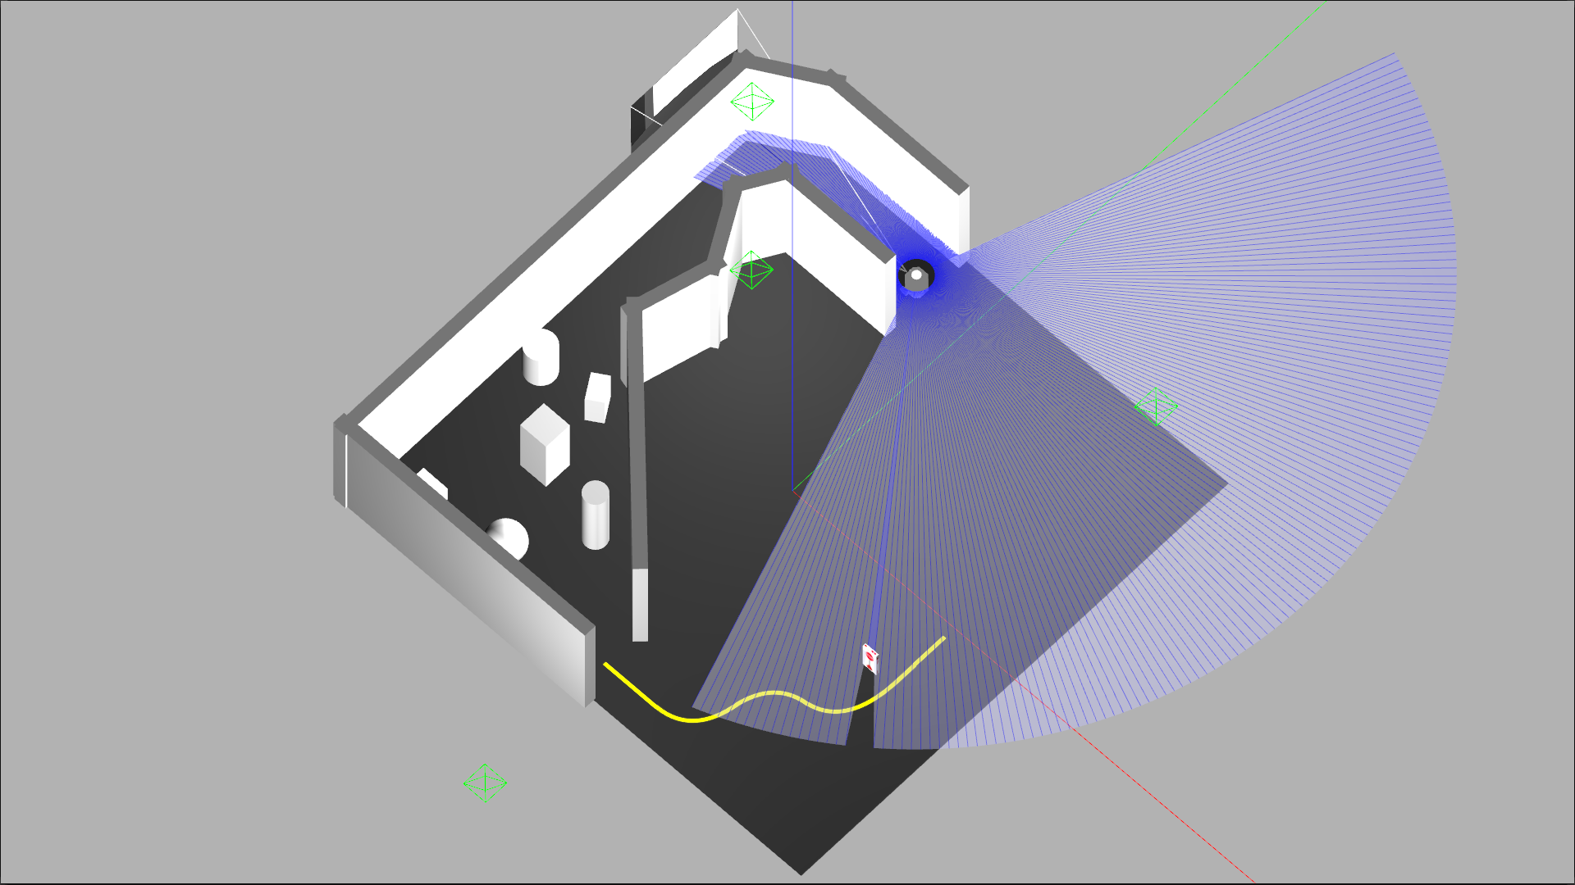
Project Tasks
Task 1: Wall Following
Task 2: Obstacle Avoidance
Task 3: Line Following
Task 4: Stop Sign Detection
Task 5: AprilTag Tracking

Slide 3
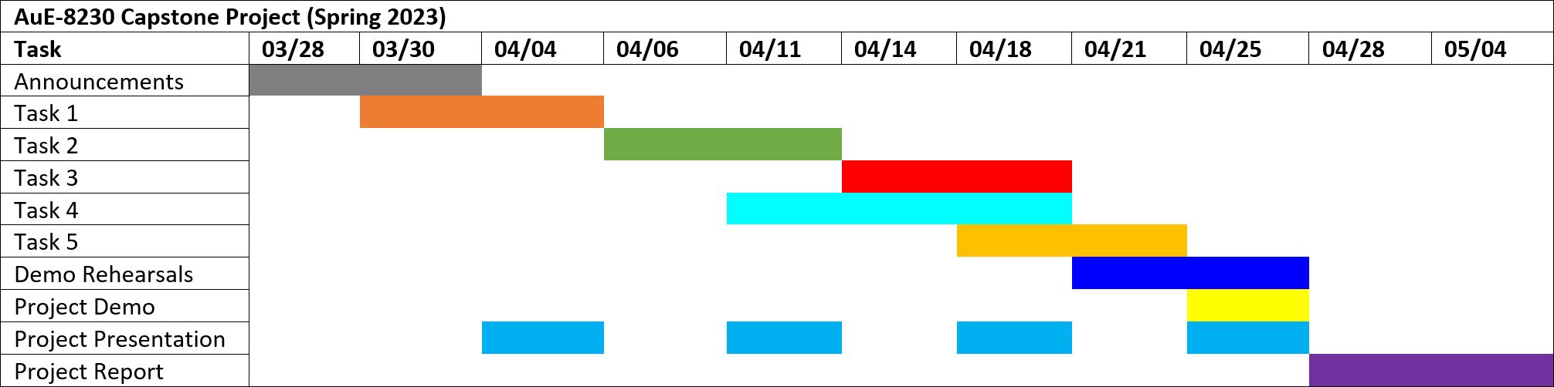
Project Timeline
Task 1: Wall Following
Task 2: Obstacle Avoidance
Task 3: Line Following
Task 4: Stop Sign Detection
Task 5: AprilTag Tracking

Slide 4
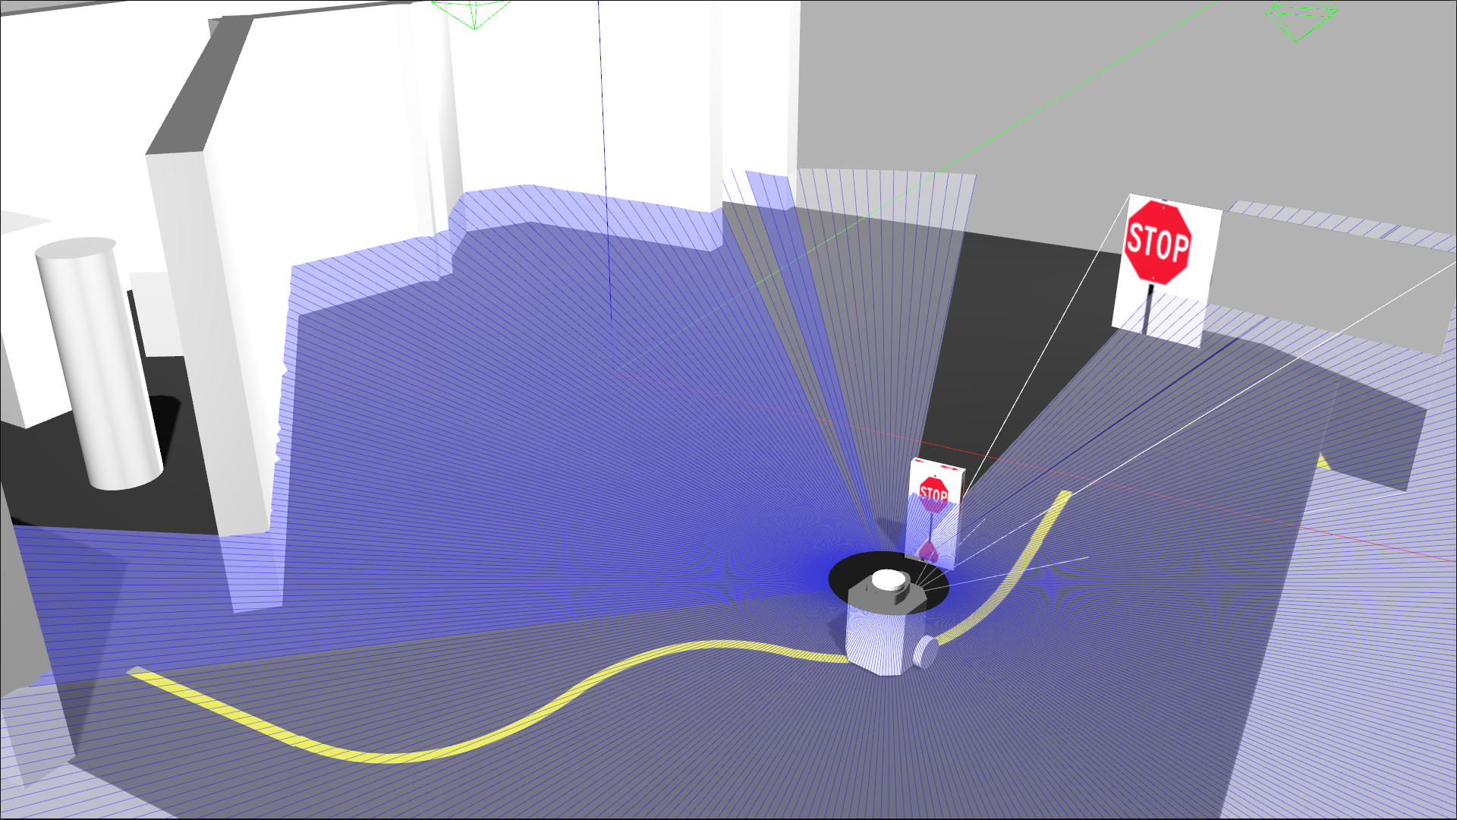
Task 4
Stop Sign Detection

Slide 5
Primary Responsibility Assignment
Algorithm development: Chinmay
Simulation setup: Tanmay
Simulation deployment: Tanmay
Real-world deployment: Chinmay
Git repository management: Tanmay
Documentation: Chinmay
Note: Responsibility does not indicate contribution. Both members contributed equally to this project and have no conflict of interest to declare.

Slide 6

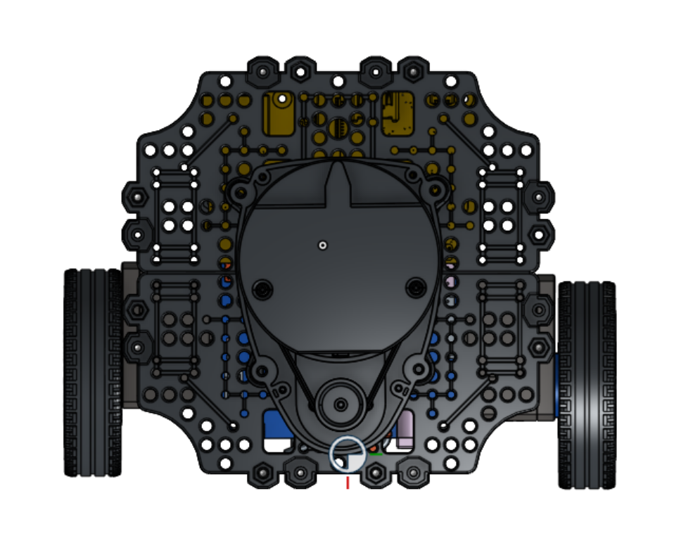
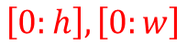
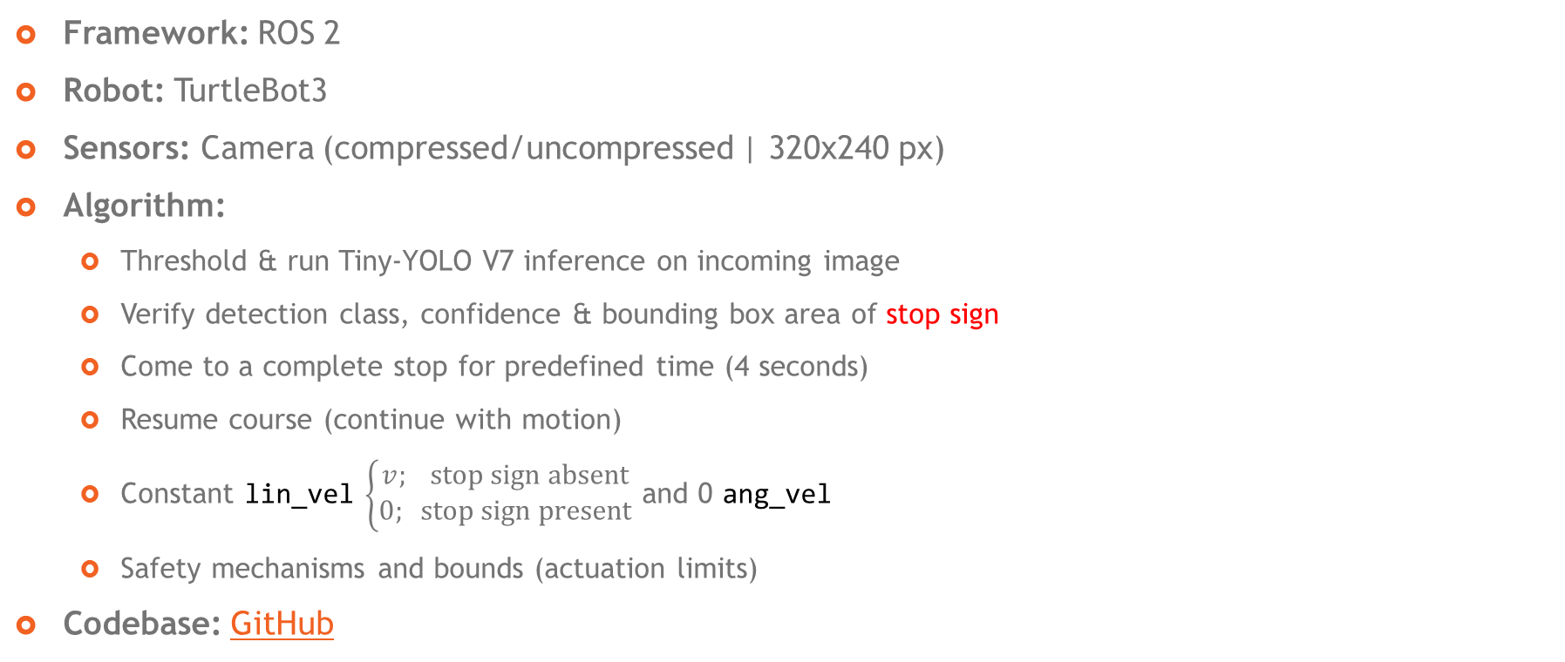
Approach
$$\left[0:h\right], \left[0:w\right]$$
Framework: ROS 2
Robot: TurtleBot3
Sensors: Camera (compressed/uncompressed | 320x240 px)
Algorithm:
Threshold & run Tiny-YOLO V7 inference on incoming image
Verify detection class, confidence & bounding box area of stop sign
Come to a complete stop for predefined time (4 seconds)
Resume course (continue with motion)
Constant lin_vel $\left\{\begin{aligned}v; \text{stop} \text{sign} \text{absent} \\ 0; \text{stop} \text{sign} \text{present}\end{aligned}\right.$ and 0 ang_vel
Safety mechanisms and bounds (actuation limits)
Codebase: GitHub

Slide 7
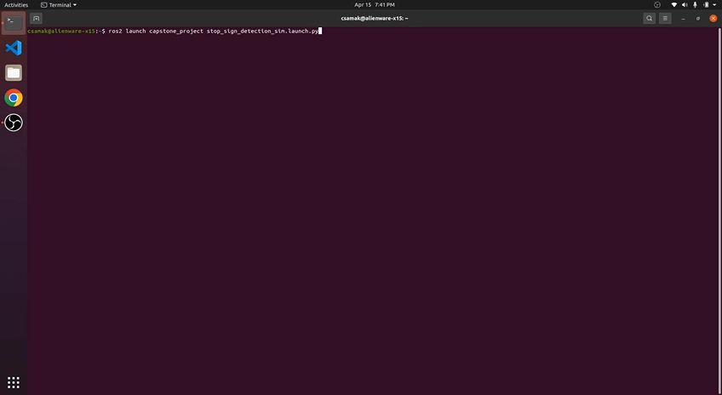
Simulation Results

Slide 8
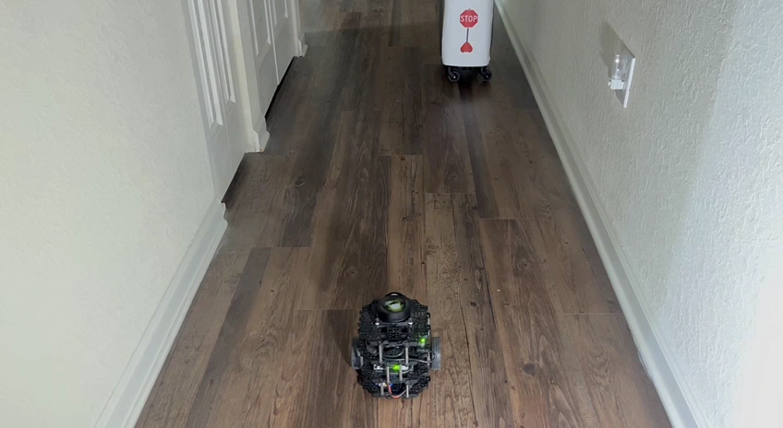
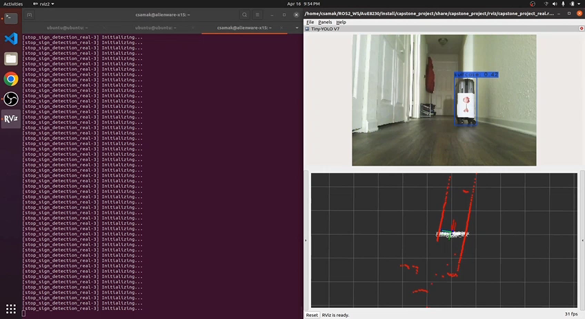
Real-World Results
Robot
Remote PC

Slide 9

Progress and Next Steps
Task 1: Wall Following
Task 2: Obstacle Avoidance
Task 3: Line Following
Task 4: Stop Sign Detection
Task 5: AprilTag Tracking
Calibration and optimization for final demo

Slide 10
Challenges Faced
ROS 2 TurtleBot3 URDF size
ROS 2 DDS communication framework
Domain ID not robust to network traffic fluctuations
Topics not discoverable over network
Conflicting QoS profiles for sensors and actuators
Unavailable ROS 2 packages and lack of resources
Gazebo world and texture setup for ROS 2
Gazebo residual errors and crashes

Slide 11
Thank you!
…open to questions and suggestions

